Slide 1
Flight price prediction
Ravi prakash bajpai

Slide 2
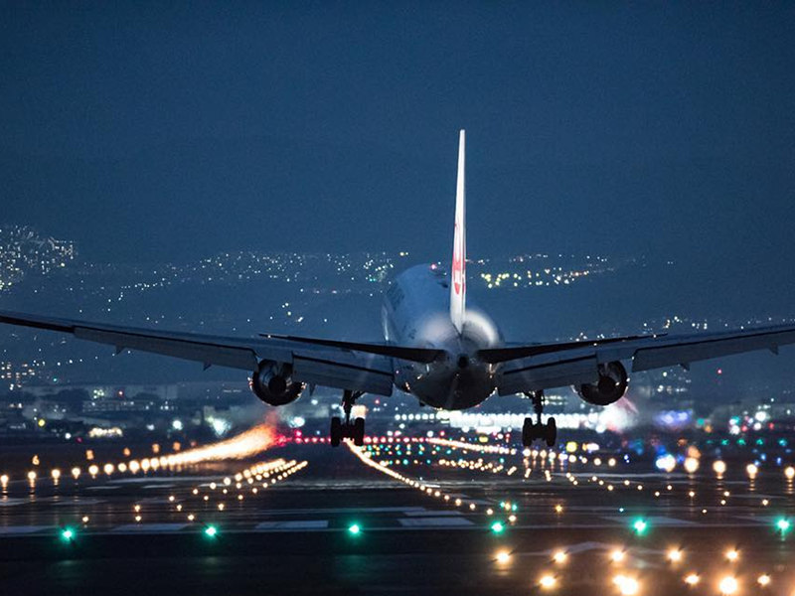
Flight price prediction

Slide 3
ACKNOWLEDGMENT
For this project data has been collected through web scraping. Data from different website has been scraped,these are the following websites
Makemytrip.com
easemytrip.com
www.cleartrip.com
tickets.paytm.com
I have also taken help from many other websites ,some of them are mentioned below
https://towardsdatascience.com/
https://www.geeksforgeeks.org/
https://www.analyticsvidhya.com/
https://www.kaggle.com.

Slide 4
INTRODUCTION
This project Flight price prediction is mainly built to predict the price of the air ticket for any future date.
Generally it is seen that price for air ticket raise and fall and is unpredictable to determine the price for any future date. Variation in the price of air ticket depend on many factors such as flight name(air asia, indigo, indian airline, kingfisher), date, time to travel and many others, so considering these factors this project is built to determine near about price for any air ticket.

Slide 5
EDA
It is analysed from data set that label is continuous data and nearly all the features are categorical data.it can also seen that data is uncleaned, for cleaning the data following steps has been followed
Extracting the day and month from the date.
Dropping the unnecessary features from the data set(unnamed: 01).
Extracting the hour and minute from departure and arrival features.
From time of travel extracting the no. of hour to travel.
Converting the "no. of stop" from string data type to numeric by using replace function.
Many features are object data type converting them into numeric form by applying label encoder.

Slide 6
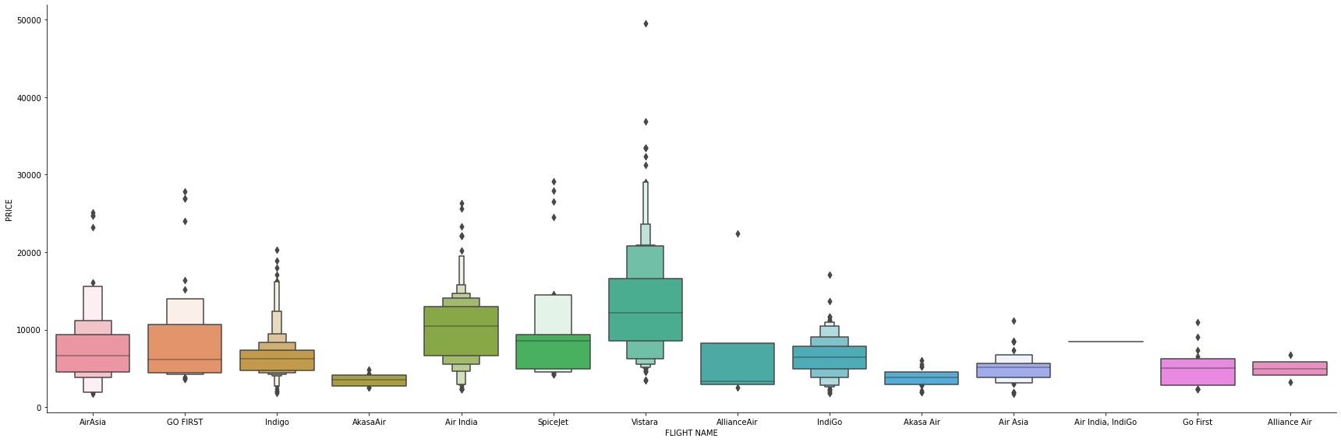
Visualizations
Plotting different plot to show the relationship among features and between features and label
Plotting Price vs Airline plot

Slide 7
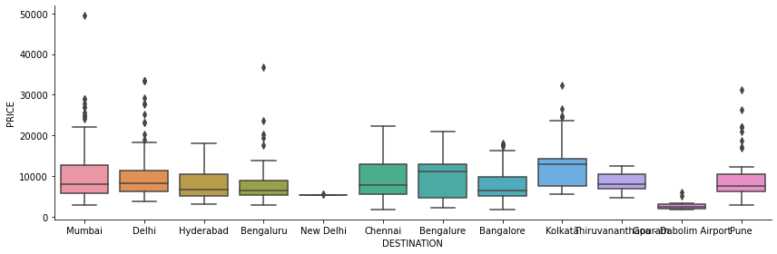
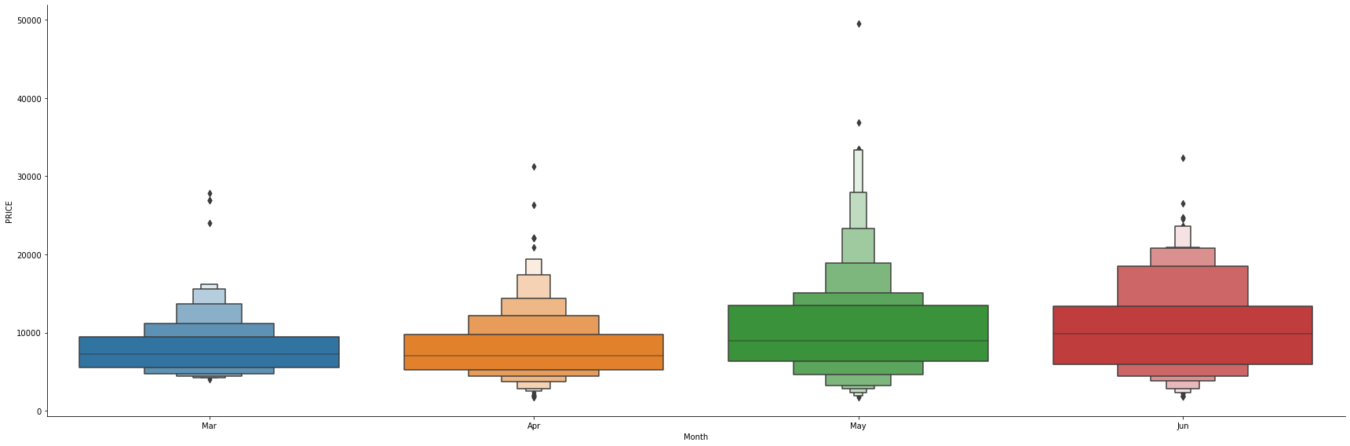
Visualizations
Plotting Box plot for Price vs Destination
Plot box for price and month

Slide 8
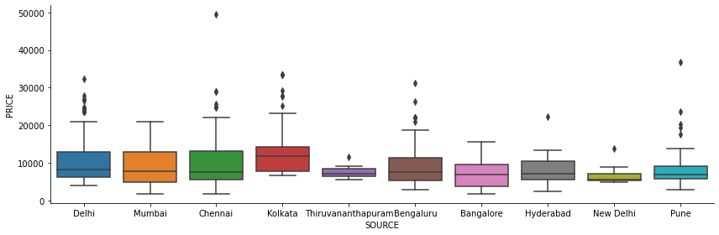
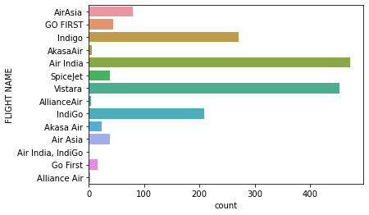
Visualizations
Count of no of flight for different airlines
Plotting Box plot for Price vs Source

Slide 9
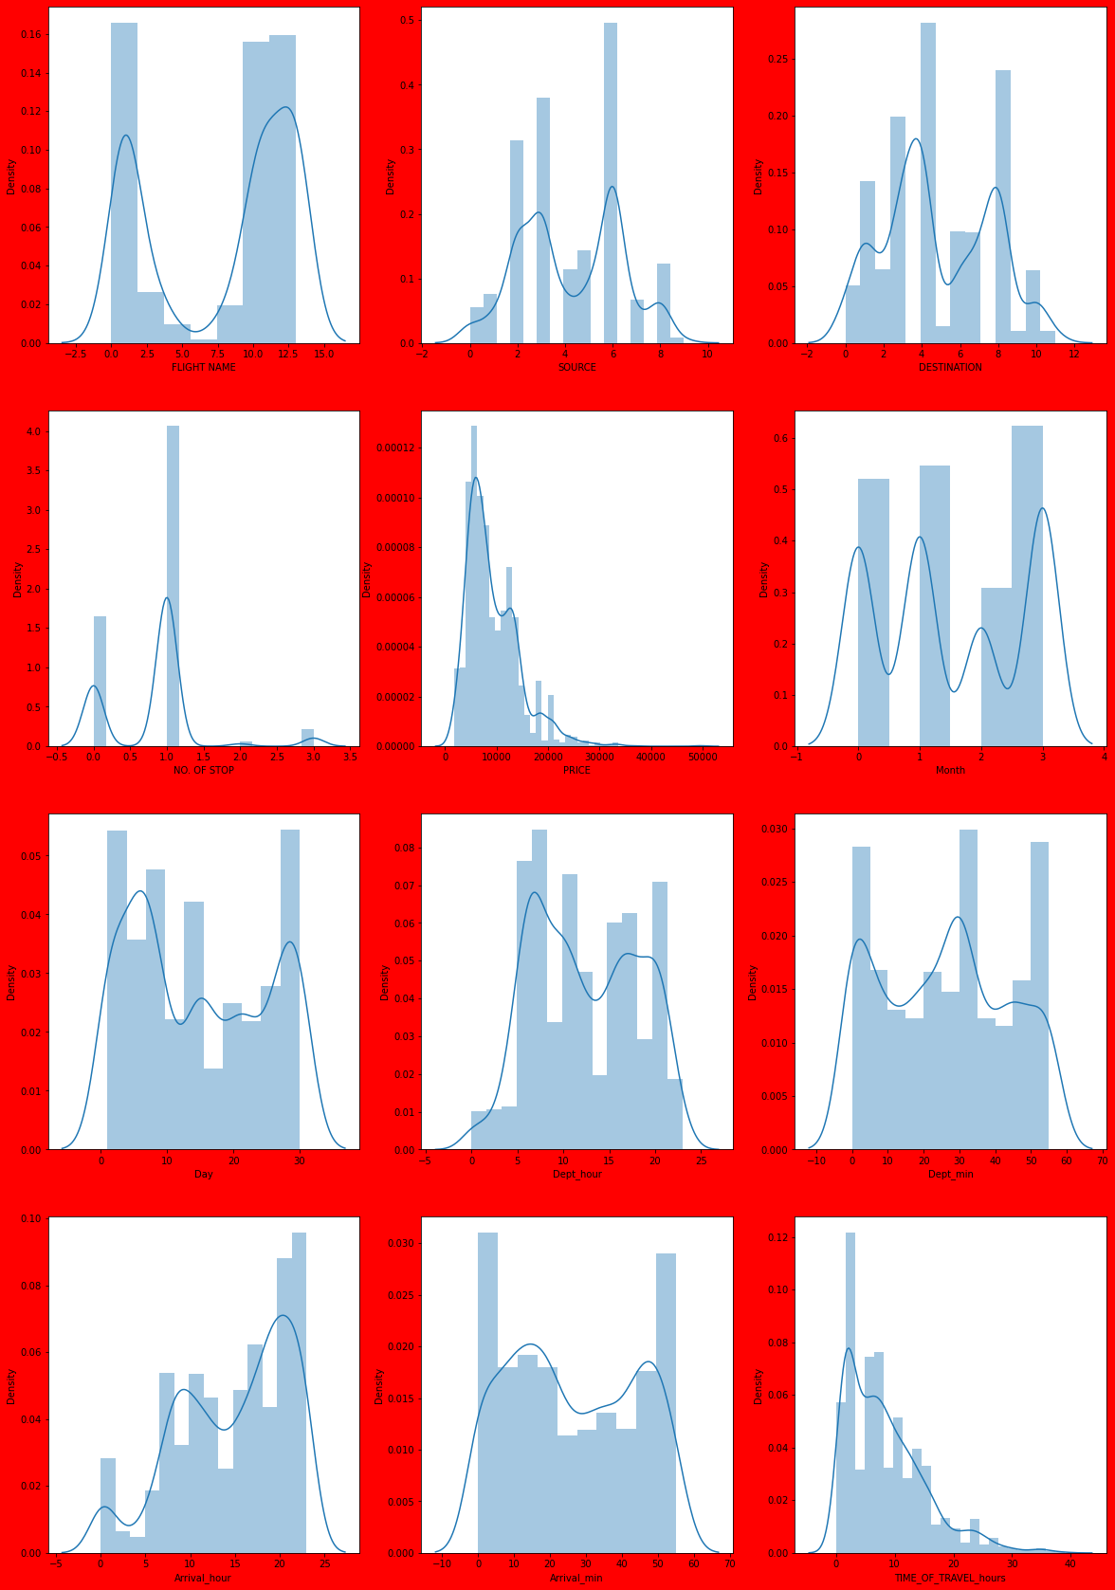
Visualizations
Plotting Displot to show wheather data is normalized or not

Slide 10
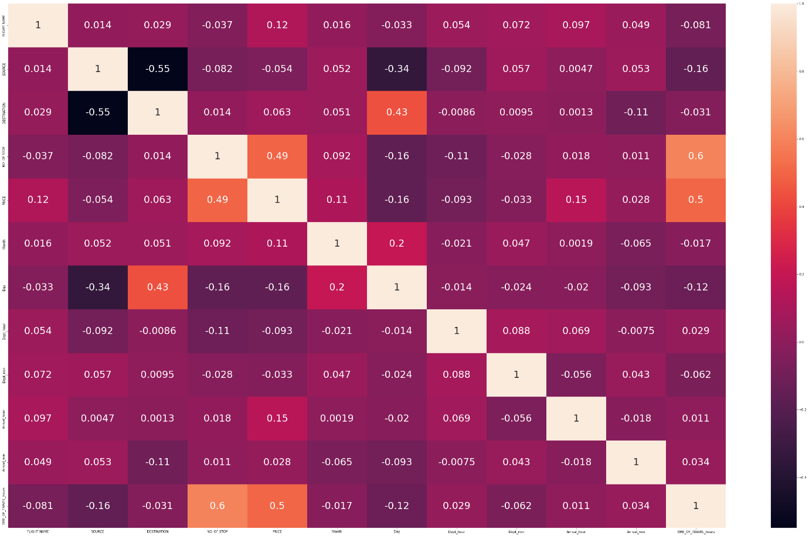
Visualizations
Heat map showing the multicollinearity among the features and between the features and label.

Slide 11
CONCLUSION
It can be concluded that through this project air ticket for any future date can be predicted and accordingly traveller can buy the ticket. it can be concluded that price of air ticket mainly vary due to two factors first how much time before ticket was booked, larger the time cheaper the ticket. Secondly from which flight passenger is traveling that is name of the flight.

Slide 12
END

